Slide 1
Cyber Security

Slide 2
Ethical Hacking
Ethical hackers follow processes of a malicious hacker.
They see how hackers could gain information or exploit a service to find vulnerabilities.
They assess the security of a service with permission of the organization.

Slide 3
Ethical Hacking
Ethical Hackers Try to Answer the Following Questions
What can an intruder do with that information?
Does anyone at the target organization notice the intruders’ attempts or successes?
Are all components of the information system adequately protected, updated, and patched?
How much time, effort, and money are required to obtain adequate protection?
Are the information security measures in compliance with legal and industry standards?

Slide 4
Ethical Hacking
Steps in Hacking a System
Footprinting and Reconissaince
Scanning
Enumeration
Vulnerability Analysis
System Hacking

Slide 5
Footprinting/ Reconaisance
Peparatory phase, gathering as much information as possible to easily find ways to intrude into the target.
Active & Passive Footprinting
Information Goals:
Network information
System information
Organizational information
Notes:
Network Info (DOmains/sub-domains, network blocks, network topology, routers, firewalls, ip addresses, reachable systems, whois records, dns records)
System Info (Web server OS, location of web servers, email addresses, usernames, passwords)

Slide 6
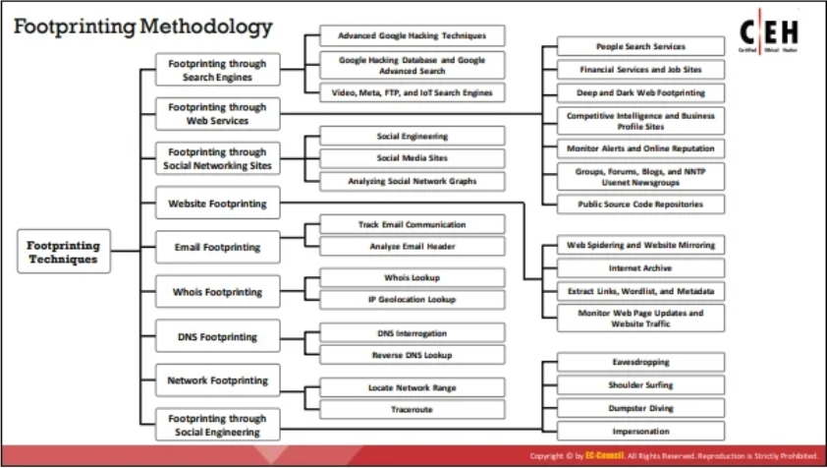
Footprinting/ Reconaisance
Notes:
Network Info (Domains/sub-domains, network blocks, network topology, routers, firewalls, ip addresses, reachable systems, whois records, dns records)
System Info (Web server OS, location of web servers, email addresses, usernames, passwords)

Slide 7
Scanning
Searching for an entry point
Determining whether a target system is active/inactive
Extended Reconnaissance
Discovering exploitable communication channels
Discovering configuration/patch lapses
Develop attack Strategy
Notes:
Network Info (Domains/sub-domains, network blocks, network topology, routers, firewalls, ip addresses, reachable systems, whois records, dns records)
System Info (Web server OS, location of web servers, email addresses, usernames, passwords)

Slide 8
Scanning
Information Goals:
Active Hosts
Open Ports
IP Addresses
Exploitable Applications
OS version
more
Notes:
Network Info (Domains/sub-domains, network blocks, network topology, routers, firewalls, ip addresses, reachable systems, whois records, dns records)
System Info (Web server OS, location of web servers, email addresses, usernames, passwords)

Slide 9
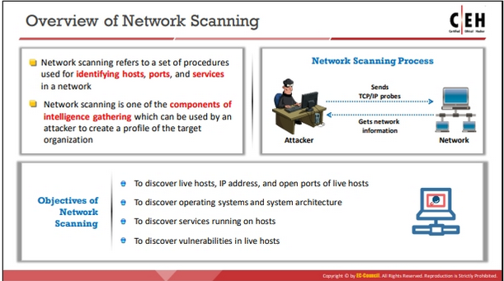
Scanning
Notes:
Network Info (Domains/sub-domains, network blocks, network topology, routers, firewalls, ip addresses, reachable systems, whois records, dns records)
System Info (Web server OS, location of web servers, email addresses, usernames, passwords)

Slide 10
Enumeration
EVEN MORE information gathering
First identifying step of an attack
Looking for detailed information and extracting it
such as:
Usernames
Passwords
Active Directory Information
Network resources
Network shares
Routing tables
Audit and service settings SNMP and FQDN details
Machine names
Users and groups
Applications and banners
Notes:
Network Info (Domains/sub-domains, network blocks, network topology, routers, firewalls, ip addresses, reachable systems, whois records, dns records)
System Info (Web server OS, location of web servers, email addresses, usernames, passwords)

Slide 11
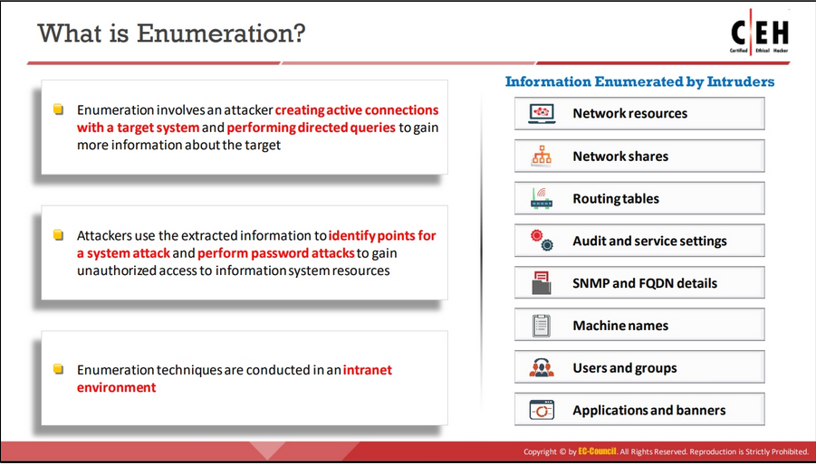
Enumeration
Notes:
Network Info (Domains/sub-domains, network blocks, network topology, routers, firewalls, ip addresses, reachable systems, whois records, dns records)
System Info (Web server OS, location of web servers, email addresses, usernames, passwords)

Slide 12
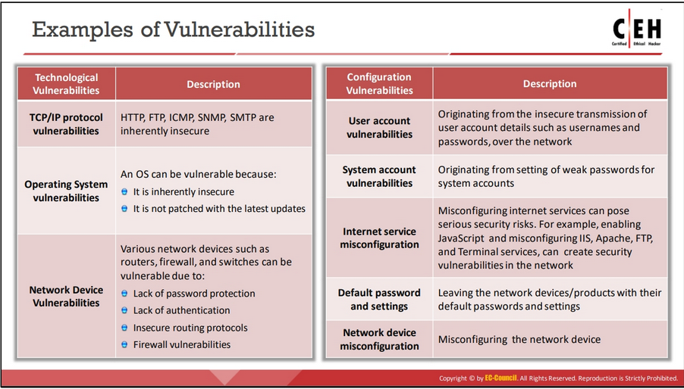
Vulnerability Assesment
Using all the information gathered to determine any possible ways to attack a system
Notes:
Network Info (Domains/sub-domains, network blocks, network topology, routers, firewalls, ip addresses, reachable systems, whois records, dns records)
System Info (Web server OS, location of web servers, email addresses, usernames, passwords)

Slide 13
System Hacking
Ultimate goal of an attacker
Uses information through footprinting, scanning, enumeration, and vulnerability analysis and then uses this information to hack the target system.
Attempts to compromise Confidentiality, Integrity, or Availability of a System
Notes:
Network Info (Domains/sub-domains, network blocks, network topology, routers, firewalls, ip addresses, reachable systems, whois records, dns records)
System Info (Web server OS, location of web servers, email addresses, usernames, passwords)

Slide 14
System Hacking
Attackers try to:
Gain Access
Escalate Privileges
Damage
Maintain Access
Clear Logs
Of a system/system session
Notes:
Network Info (Domains/sub-domains, network blocks, network topology, routers, firewalls, ip addresses, reachable systems, whois records, dns records)
System Info (Web server OS, location of web servers, email addresses, usernames, passwords)

Slide 15
Website Footprinting Lab
Goal: - find the
Notes:
Network Info (Domains/sub-domains, network blocks, network topology, routers, firewalls, ip addresses, reachable systems, whois records, dns records)
System Info (Web server OS, location of web servers, email addresses, usernames, passwords)

